Slide 1
Some thoughts on VIS + (D)H How to not hammer the Arts & Humanities
Florian WINDHAGER
Department for Arts & Cultural Studies University for Continuing Education Krems

Slide 2
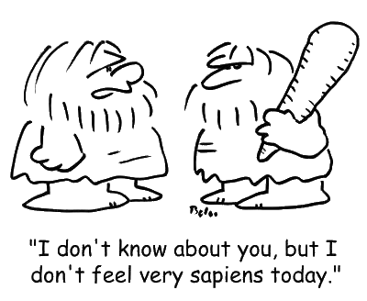
„ I don‘t know about you, but I don‘t feel very sapiens today.“
[c] jantoo

Slide 3
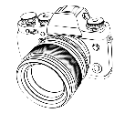

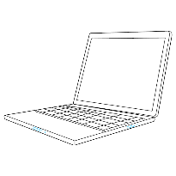
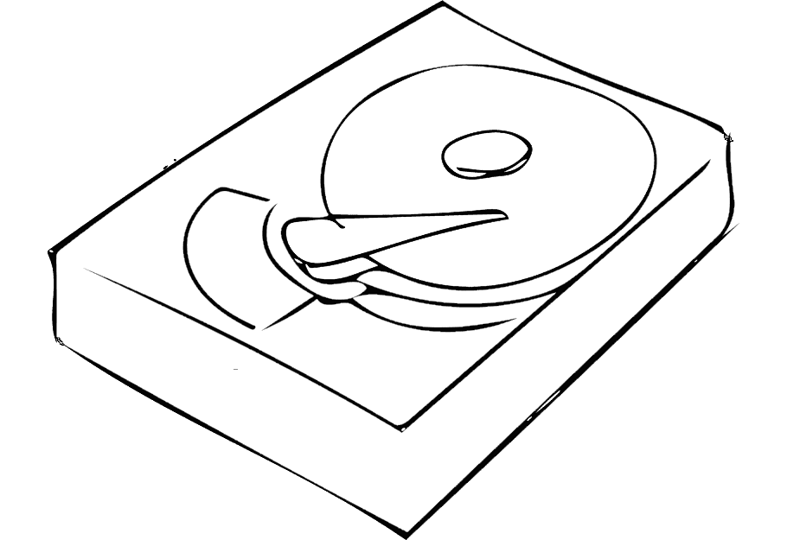
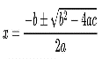

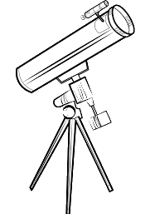
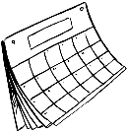
Modernity brings a multitude of
severe cognitive challenges
 to which cultures respond with cultural & technical augmentations & extensions of cognition (“things that make us smart”)
nation states
political systems
semantic networks
science
microbes
stock markets
climate change
inequality
pandemics
…
history
complex cultural things
perception
✗
!
?
cognition
extended !
VIS !
✗
action
information technology and multimodal interfaces as evolutionary game changer

Slide 4
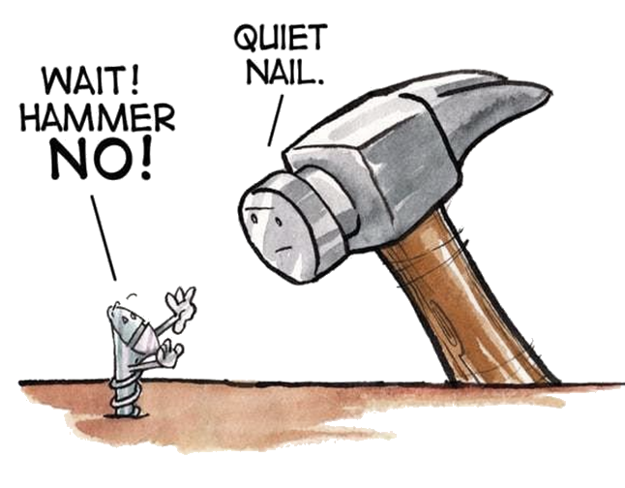
„ VIS 4 DH “
complex, multi-methodological,
critical, and mostly language-based, thinking and reasoning in the ever-evolving interpretive discourse of the arts and humanities
Source: https://img.huffingtonpost.com/asset/5a473e321d000018005c17ca.jpg?ops=scalefit_630_noupscale

Slide 5
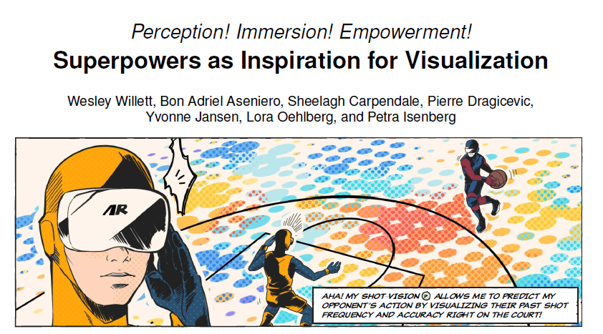
„ VIS 4 DH “
vs.
Willet et al., 2021

Slide 6
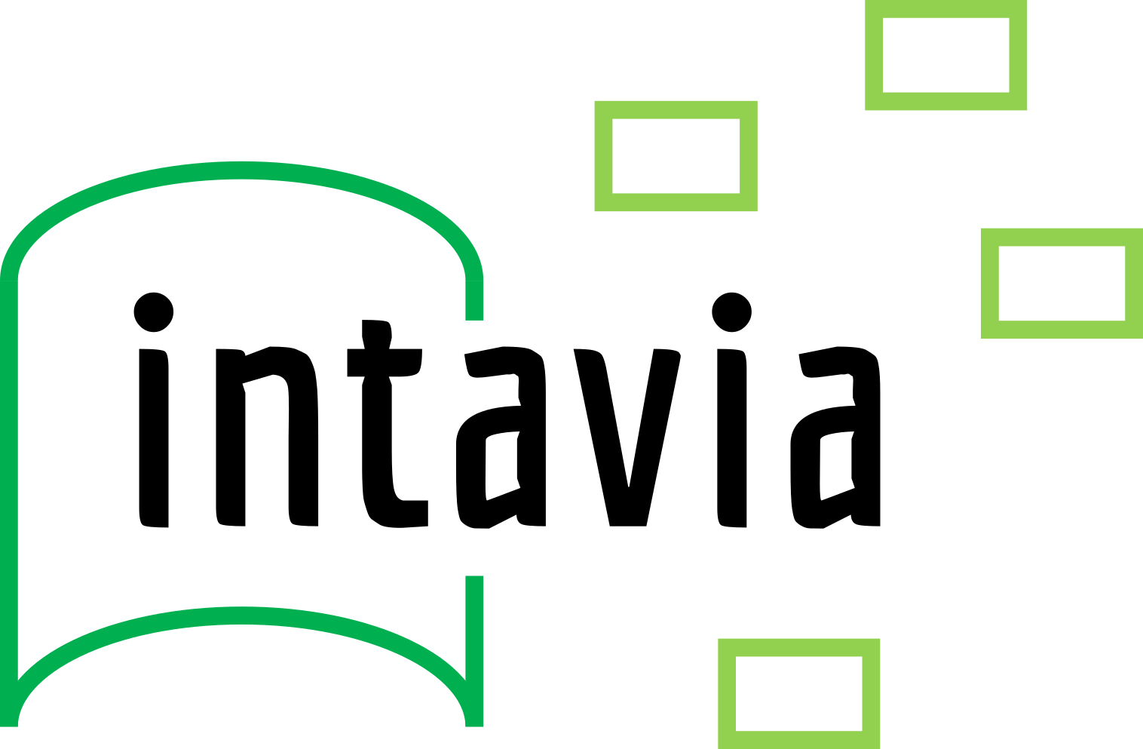
H2020 Project „In/Tangible European Heritage: Visual Analysis, Curation and Communication“
material object collections
digital object databases
1) Data Curation Lab
2) Visual Analytics Studio
1a) Search
3) Storytelling Suite
1
1b) Creation
Europeana
2
present-day, non-expert audiences
3 1c) Curation
sources from the past
DE
3
4 2)) Analysis
InTaVia knowledge graph
FI
NL
3) Communication
AT
SI
biographies & (hi)stories
digital national biography DBs
multiple types
of expert users
multiple types of cognition & action
narrative designs
for in/tangible histories

Slide 7
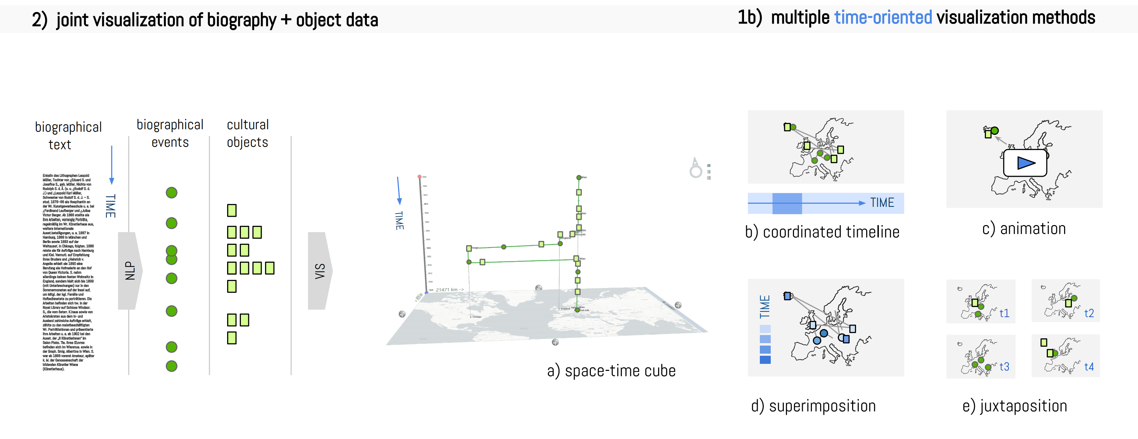
Which distant views can support the study of biographies?
close-up view
distant
views:
net vis
set vis
stat vis
geo vis
time vis
One view is not enough!
a) coord. timeline
b) animation
c) color-coding
d) data comics
e) space-time cube
How to represent biographical time in all distant views?

Slide 8
Design strategy:
Multiperspectivity (= “Multiple Views”)
!
!
!
!
!
Know your VIS methods’ strengths and limitations!

Slide 9
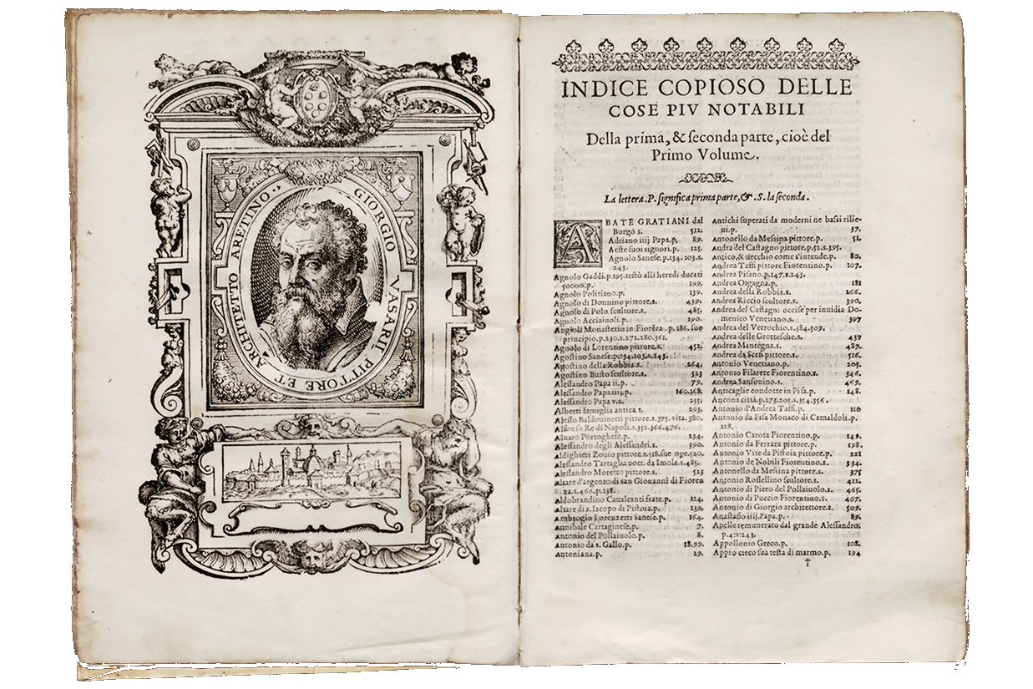
digital distant reading & viewing support
traditional theoretization of culture
Build post-digital tools for scalable reading & viewing!
(Vasari, 1550)
TH practices
DH practices
digital close reading & viewing support
lives of artists
artworks
traditional close reading & viewing

Slide 10
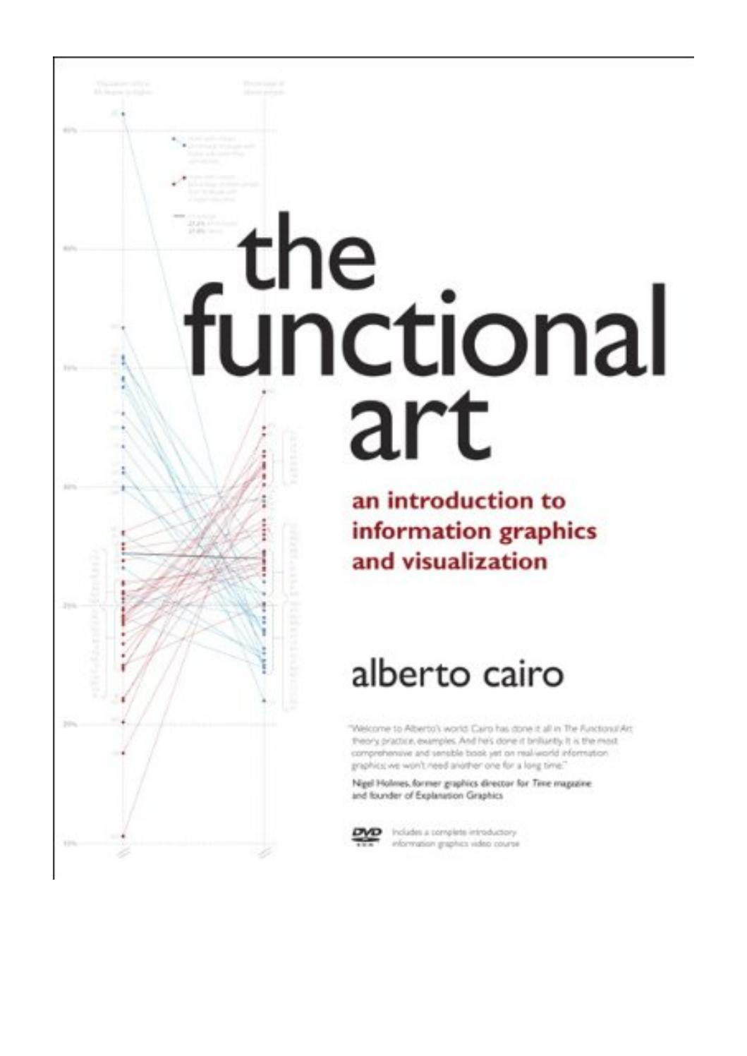

the
artful
art
the
playful
art
&
&
Dare to create pretty & autotelic pictures!
In defense of sandcastles!
McCandless, 2012
Hinrichs et al., 2019

Slide 11
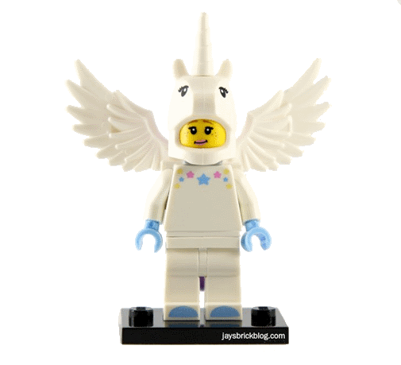
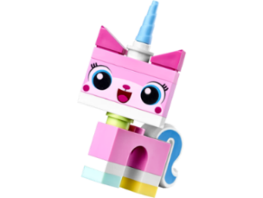
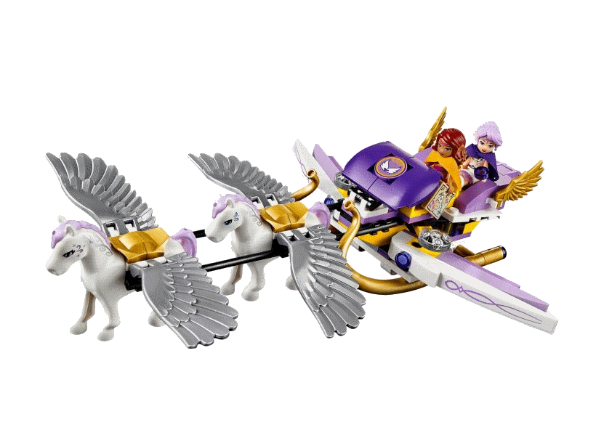
Statistik
Design
Inhaltliche
Expertise
Traditionelle
Methoden
+
Don’t wait for unicorns, let’s build them!
Programmierung
Theorie, Ästhetik
& Rhetorik
(your personal DH team)
Creating a great data visualization is not just about knowing how to code in JavaScript, or choosing good colors or layout, or even knowing how to work with data: it’s all three. And people who are great at all three of those skills — programming, design, and statistics — just don’t exist. I call them the Unicorns. (Schwabish, 2015)
Let’s build unicorn-powered eleven spaceships, which integrate traditional and digital intelligence, plurality and compatibility, distant viewing and close viewing, analytics und hermeneutics, computer vision and human vision, description and critique, utility and beauty, … - and start right here!

Slide 12

florian.windhager@donau-uni.ac.at | @windhagr
This work has received funding from the European Union H2020 research and innovation programme under grant agreement No. 101004825.

